Slide 1

Attracting and
Motivating People
OPEN SOURCE MANAGEMENT
www.osminternational.com
Notes:
1

Slide 2
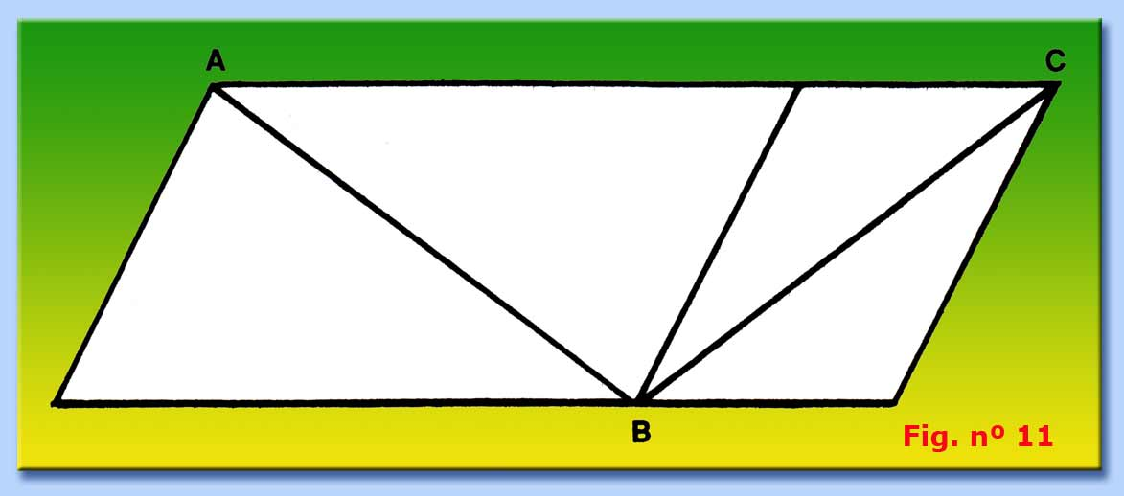
SOMETIMES THINGS ARE
NOT AS THEY APPEAR

Slide 3
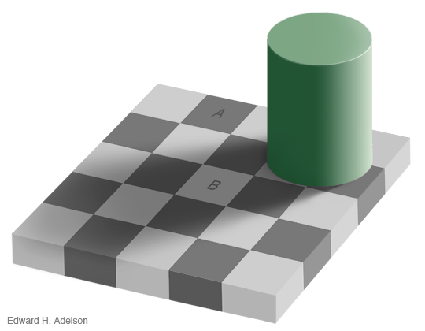

Slide 4
Are the colors of Square A and Square B the same???

Slide 6
MANY PRACTICES AND ATTITUDES THAT CREATE PROSPERITY ARE COUNTERINTUITIVE – THEY SEEM TO GO AGAINST LOGIC

Slide 7
20% people →80% wealth
80% people→20% wealth

Slide 8
Generate Value
Most people do not make emotional sacrifices

Slide 9
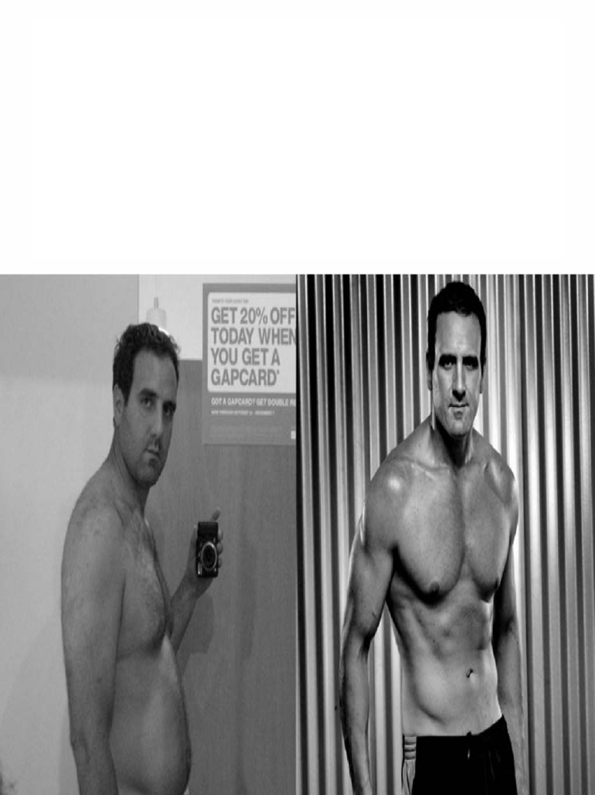
Comfort Zone Uncomfortable
= =
Consuming value Creating value

Slide 10
How to
Manage People
OPEN SOURCE MANAGEMENT
www.osminternational.com
Notes:
10

Slide 11
CHALLENGES
WITH PEOPLE

Slide 12
Control
To get things to go as you wish (the ability to influence something positively)

Slide 13
Responsibility
  THE FEELING OF BEING THE ONLY ONE IN CHARGE OF SOMETHING
  =
  THE ABILITY TO SEE ONESELF AS “THE CAUSE”

Slide 14


PROBLEM
    CAUSE
    (=Source Point)
EFFECT
(=Receipt Point)

Slide 15
Cause and Effect
To solve a problem or to handle succesfully a situation we need to see ourselves as “the cause” of such situation.
If we aren’t able to do it, it is the situation that is controlling us.
If we are not capable of seeing ourselves as «the cause» of the performance of our colleagues, we are indeed leaving the control to them.
Case history scuola

Slide 16
The Scale of Effectiveness
OTHER DETERMINED
They think that all their lives and misfortunes are or have been dependent upon others and circumstances
SELF DETERMINED
They see themselves as «the cause» only of the activities performed directly but cannot «accept blame» for other people mistakes.
They will not reach their goals
LEADERS
They see themselves as the cause of their actions but also as the cause of other people actions and activities.

Slide 17
Motivation
OPEN SOURCE MANAGEMENT
www.osminternational.com
Notes:
17

Slide 18
The improductive employee is like a locked door
    CAUSE
    (= Source Point)
EFFECT
(= Receipt Point)

Slide 19
Exercise
1. Good working conditions
2. To feel involved in work related problems
3. Non oppressive discipline
4. Full appreciation for the work done
5. Management loyalty toward the staff
6. Good salary level
7. Job Promotions and growing with the company
8. Understanding and concern for employee’s personal problems
9. Job Security
10. Interesting Work

Slide 20
Упражнение
Добри условия за работа
Ангажираност в проблемите на работата
Дисциплина, която не потиска хората
Пълно признание за свършената работа
Лоялност от страна на ръководството
Добро ниво на заплащане
Повишения и израстване във фирмата
Разбиране и истински интерес към личните проблеми
Сигурност за работното място
Интересна работа

Slide 21
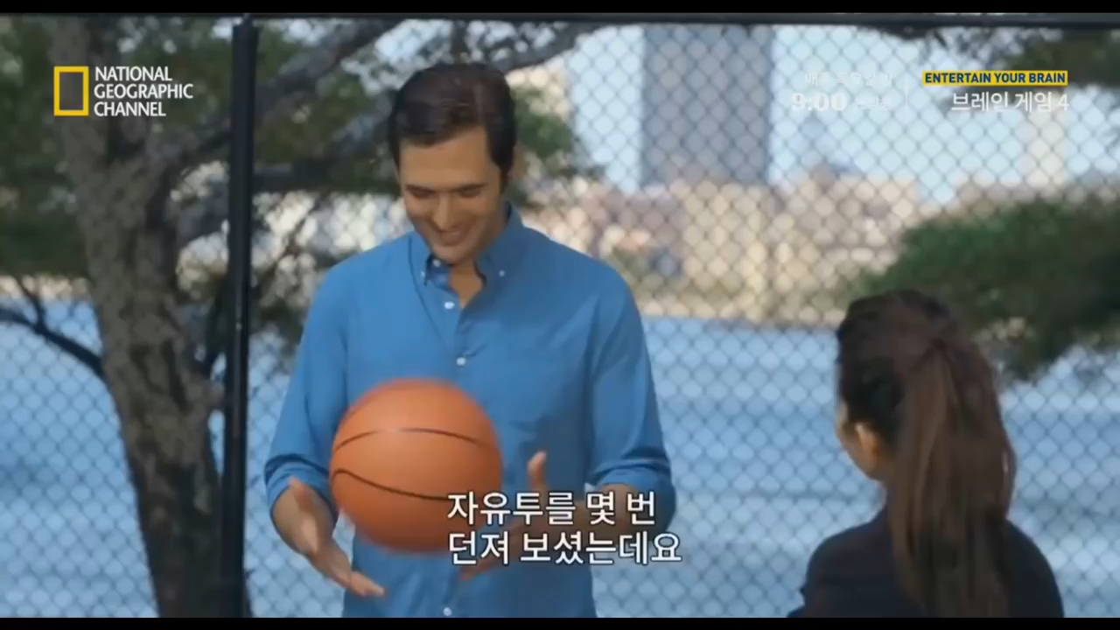

Slide 22



Slide 23
Praise
People tend to repeat the behavior(s) for which they are praised
If you don’t praise people, they will work for the money – but their passion will be elsewhere

Slide 24
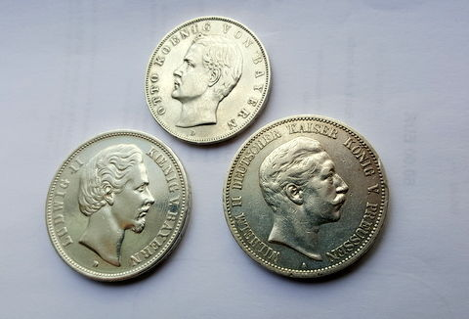

Slide 25
WHAT DO THEY WANT
Full appreciation for the work done (PRAISE)
To feel involved in work related problems
Understanding and concern for employee’s personal problems
Salary and commissions
Job Security
Interesting Work
Job Promotions and growing with the company
Management loyalty toward the staff
Good working conditions
10. Non oppressive discipline

Slide 26
NO CHANGE
2 months of patient training and no results or change (things go back on your plate)
Your attempts to motivate the person backfire or are used against you
If productivity keeps low, either the person has a difficult personal situation, either they have another goal

Slide 27
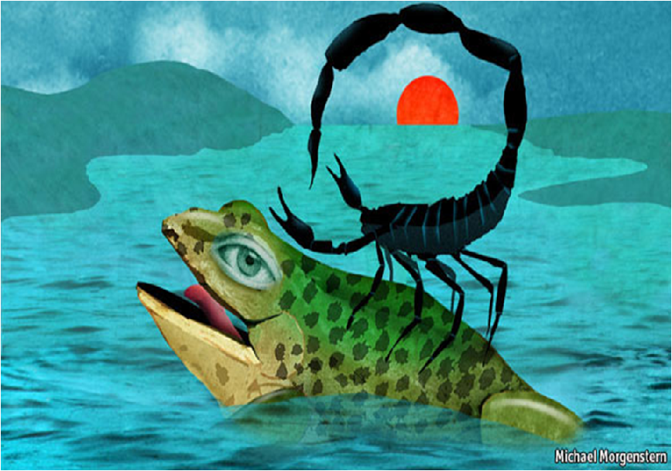

Slide 28
You as the Owner
OPEN SOURCE MANAGEMENT
www.osminternational.com
Notes:
28

Slide 29
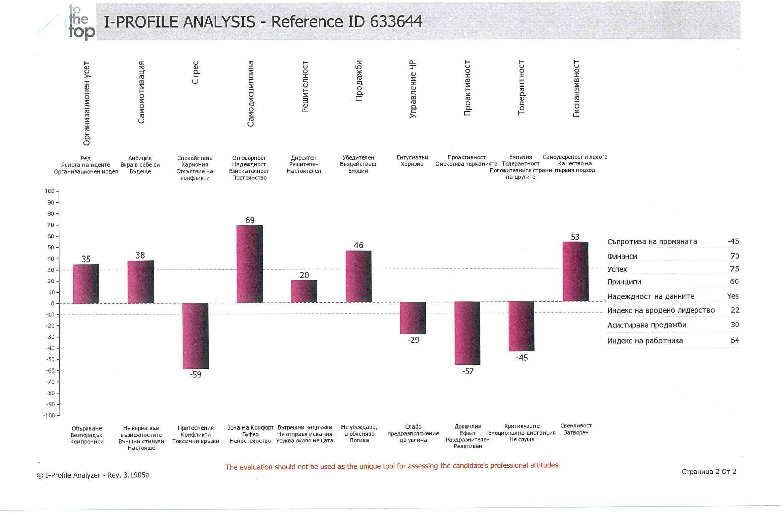

Slide 30
СПЕШНО VS. ВАЖНО
Коя е тази дейност, която, когато се извършва редовно през следващите месеци (години), би направила огромна разлика за вашата компания или вашата работа?

Slide 31
Законът на Паркинсон
«Времето, с което разполагаме, за да изпълним една задача,
е точно толкова…
…колкото времето, необходимо,
за да я изпълним».

Slide 32
THE COMPANY MIRRORS THE MANAGER
1) To grow as a company you need to have a program to improve yourself
If you want things to change, you have to change first

